Slide 1

Algorithm Design-II (CSE 4131)
TERM PROJECT REPORT
(March'2023-July'2023)
On
DIGITAL MAPPING SERVICES IN GOOGLE MAPS BASED ON DIJKSTRA ALGORITHM
Submitted By
SUDIPTA PANDA
Registration No.: ____2141016059_____
B.Tech. 4th Semester CSE (C)
Department of Computer Science and Engineering
Institute of Techinical Education and Research
Siksha ‘O’ Anusandhan Deemed To Be University
Bhubaneswar, Odisha-751030

Slide 2
DECLARATION
I, Sudipta Panda, bearing registration number 2141016059 do hereby declare that this term project entitled “DIGITAL MAPPING SERVICES IN GOOGLE MAPS BASED ON DIJKSTRA ALGORITHM” is an original project work done by me and has not been previously submitted to any university or research institution or department for the award of any degree or diploma or any other assessment to the best of my knowledge.
SUDIPTA PANDA
Regd.No.:2141016059
Date:12th JUNE,2023

Slide 3
CERTIFICATE
This is to certify that the thesis entitled “Digital Mapping Services In Google Maps Based On Dijkstra Algorithm” submitted by Sudipta Panda, bearing registration number 2141016059 of B.Tech. 4th Semester Comp. Sc. and Engg.,ITER, SOA DU is absolutely based upon my own work under my guidance and supervision.
The term project has reached the standard fulfilling the requirement of the course Algorithm Design 2 (CSE4131). Any help or source of information which has been available in this connection is duly acknowledged.
Satya Ranjan Das
Assistant Professor,
Department of Comp. Sc. And Engg.
ITER, Bhubaneswar751030,
Odisha, India
Prof. (Dr.) Debahuti Mishra
Professor and Head,
Department of Comp. Sc. and Engg.
ITER, Bhubaneswar751030,
Odisha, India

Slide 4
ABSTRACT
This project focuses on utilizing Dijkstra's algorithm to solve the shortest path problem in online network services, specifically using Google Maps as the underlying tool. The objective is to develop a method that calculates the shortest route between two locations by leveraging graph theory principles and implementing Dijkstra's algorithm.
The study treats India as a graph, with cities or places represented as vertices and the routes between them as edges. By applying Dijkstra's algorithm, the shortest paths between any two cities or places in India can be determined, enabling efficient navigation and distance calculation. The algorithm starts from a source node and progressively explores neighboring nodes, selecting the locally optimal choices at each step to arrive at the overall best solution.
Google Maps serves as the primary tool for calculating the shortest distance between starting and ending points. It provides an extensive mapping service with features like route planning, street views, real-time traffic conditions, and satellite imagery. By incorporating the graph theoretical approach and Dijkstra's algorithm, the study aims to enhance the shortest route evaluation process in Google Maps.

Slide 5
The implementation of Dijkstra's algorithm involves initializing distances, calculating distances to adjacent nodes, and iteratively selecting the node with the minimum distance. The algorithm updates the distances of neighboring nodes and maintains a shortest-path tree until all nodes have been visited. The output includes the shortest distances and paths from the source node to each vertex.
The provided Java code demonstrates the implementation of Dijkstra's algorithm using an adjacency matrix representation of the graph. The code initializes distances, performs the necessary calculations, and outputs the shortest distances and paths.
In conclusion, this project showcases the successful application of Dijkstra's algorithm and graph theory principles to solve the shortest path problem in online network services. By leveraging the capabilities of Google Maps, the study contributes to the development of an efficient method for evaluating and navigating the shortest routes between locations.

Slide 6
CONTENTS
INTRODUCTION
REAL LIFE APPLICATIONS
PROBLEM STATEMENT
SOLUTION
MATHEMATICAL FORMULATION
ALGORITHM STEPS
CONDITIONS AND CONSTRAINTS
ASSUMPTIONS
PSEUDOCODE
DESCRIPTION OF PSEUDOCODE STEPS
EXAMPLES
CODE USING JAVA
RESULT AND DISCUSSION
LIMITATIONS
REFERENCES

Slide 7
INTRODUCTION
Dijkstra's Algorithm finds the shortest path between a given node/point and all other nodes/points in a graph. This algorithm uses the weights of the edges to find the path that minimizes the total distance (weight) between the source node/point and all other nodes/points. Here we need only two input specifications:
1 vertex
2 nodes/points
The Dijkstra Algorithm is used to identify the shortest distance along the route between two locations because numerous routes and paths link them, and the Shortest Path Algorithm can only provide a minimal distance. Google created a web mapping programme called Google Maps. It features route planning for walking, driving, bicycling, flying (beta), taking public transportation, street maps, interactive 360° street views, real-time traffic conditions, and satellite imagery. More than 1 billion people will use Google Maps each month in 2020. Initially, Google Maps was a desktop C ++ programme.

Slide 8
Real-life Applications
Dijkstra’s algorithm is one of the most popular algorithms for solving many single-source shortest path problems having non-negative edge weight in the graphs, i.e., it is to find the shortest distance between two vertices on a graph. It was conceived by computer scientist Edsger W. Dijkstra in 1956 and published three years later.
Dijkstra’s Algorithm has several real-world use cases, some of which are as follows:
Digital Mapping Services in Google Maps
Social Networking Applications
Telephone Network
IP routing to find Open shortest Path First
Flying Agenda
Designate file server
Robotic Path

Slide 9
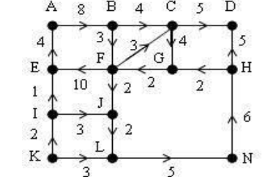
PROBLEM STATEMENT
Extract the graph from the google map. The weights in terms of cost are denoted on edges from one intersection to other. Plot the points where the lines meet at intersections as vertices. Label the vertices as A, B, C, D, E, F, G, H, I, J, K, L and M, respectively. Mark the directions mentioned in the google map for avenues and lanes.

Slide 10
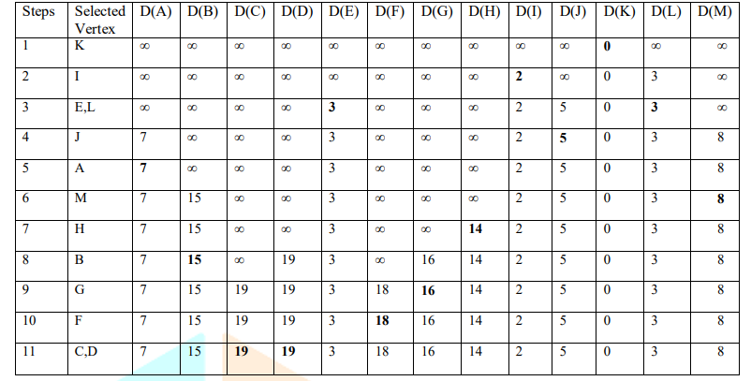
SOLUTION
The weights of the graphs differ due to parameters like speed limits, and road work distance. Latest updates on traffic data and various data are sent to the server, and these can be utilized in calculating the quickest way from one place to other.
Table: Finding the Shortest Path Using Dijkstras Algorithm
The cumulative sum of the first route direction is given by K+I+E+A+B+C+D =24, and the cumulative sum of the second route direction is given by K+L+N+H+D =19.
Here the second route is the shortest route which is the optimum.

Slide 11
MATHEMATICAL FORMULATIONS
We step through Dijkstra's algorithm on the graph used in the algorithm above
Initialize distances according to the algorithm.
Pick the first node and calculate distances to adjacent nodes.
Pick the next node with minimal distance; repeat adjacent node distance calculations.
Final result of shortest-path tree.

Slide 12
ALGORITHM STEPS
I. Set the distance of all vertices = infinity, except the source vertex. Set the distance of the source = 0.
II. Push the source vertex in the form of a min-priority queue (distance, vertex), as the min-priority queue comparison would be based on the distances of the vertices.
III. Pop the vertex with the minimum distance from the priority queue (at first, the popped vertex = source).
IV. In the case of current vertex distance + edge weight <next vertex distance, change the distance of the connected vertices to the popped vertex, then shift the vertex to the priority queue with the new distance.
V. If the popped vertex has been visited before, proceed without using it.
VI. Apply the same algorithm again until there is an empty priority list.

Slide 13
Conditions or Constraints
The value of the path cost should be positive.
The addition of edges should not form a cycle.
Can’t have negative cycles
The distance is calculated 1-to-many. Many-to-many is better.
Limited memory due to the 1-to-many approach.

Slide 14
ASSUMPTIONS
1. Graph Representation: Google Maps assumes that the road network can be represented as a graph, where each road segment or intersection is a node, and the connections between them are edges. This representation allows for efficient computation of routes and distances.
2. Connectivity: Google Maps assumes that all roads and intersections in the network are connected, meaning there is a path between any two locations. This assumption allows for a complete exploration of the graph to find the shortest path between two points using the Dijkstra algorithm.
3. Edge Costs: Google Maps assigns costs or weights to the edges of the graph based on various factors such as distance, speed limits, traffic conditions, road types, and other relevant data. These costs influence the pathfinding algorithm to determine the optimal route based on user preferences (e.g., fastest route, shortest route, etc.).

Slide 15
4. Static Data: Google Maps assumes that the underlying road network data used for routing is relatively static, meaning it doesn't change significantly within short time intervals. However, Google continuously updates and improves its map data by incorporating user feedback and other data sources to reflect real-time changes, such as road closures, construction, or traffic incidents.
5. Real-time Traffic: While the Dijkstra algorithm itself doesn't account for real-time traffic conditions, Google Maps incorporates real-time traffic data to provide dynamic routing. By leveraging additional algorithms and data sources, Google Maps can estimate traffic congestion and adjust the calculated routes accordingly to provide more accurate travel time predictions.
6. User Preferences: Google Maps assumes that users have certain preferences when it comes to route selection, such as avoiding tolls, highways, or certain types of roads. These preferences are considered during the path finding process, influencing the algorithm to prioritize or exclude specific edges based on user settings.

Slide 16
DESIGNING ALGORITHM
PSEUDOCODE
D[s] ← 0
For each v ∈ V-{s}
Do d[v] ← infinity
S ← Φ
Q ← V
Q is a priority queue maintaining -S
While Q ≠ Φ
Do u ← extract-Min(Q)
S←S ∪ {u}
For each v ∈ Adj[u]
Do if d[v] > d[u] + w(u,v)
Then d[v] ← d[u] + w(u,v)

Slide 17
DESCRIPTION OF PSEUDOCODE STEPS
In the following pseudo-code algorithm, the code v ← vertex in Q with min dist[u], searches for the vertex v in the vertex set Q that has the least dist[u] value. length(v, V) returns the length of the edge joining (i.e. the distance between) the two neighbour nodes v and V. The variable adj[u] would be the length of the path from the root node to the neighbour node V if it were to go through v. If this path is shorter than the current shortest path recorded for v, that current path is replaced with this adj[u] path. The prev array is populated with a pointer to the node on the source graph to get the shortest route to the source.

Slide 18
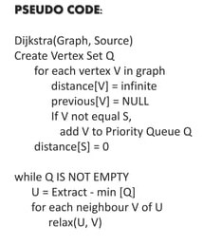
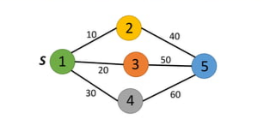
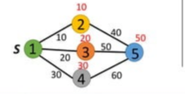
EXAMPLE

Slide 19
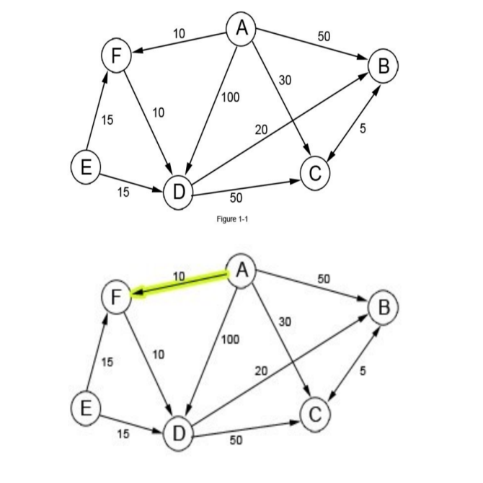
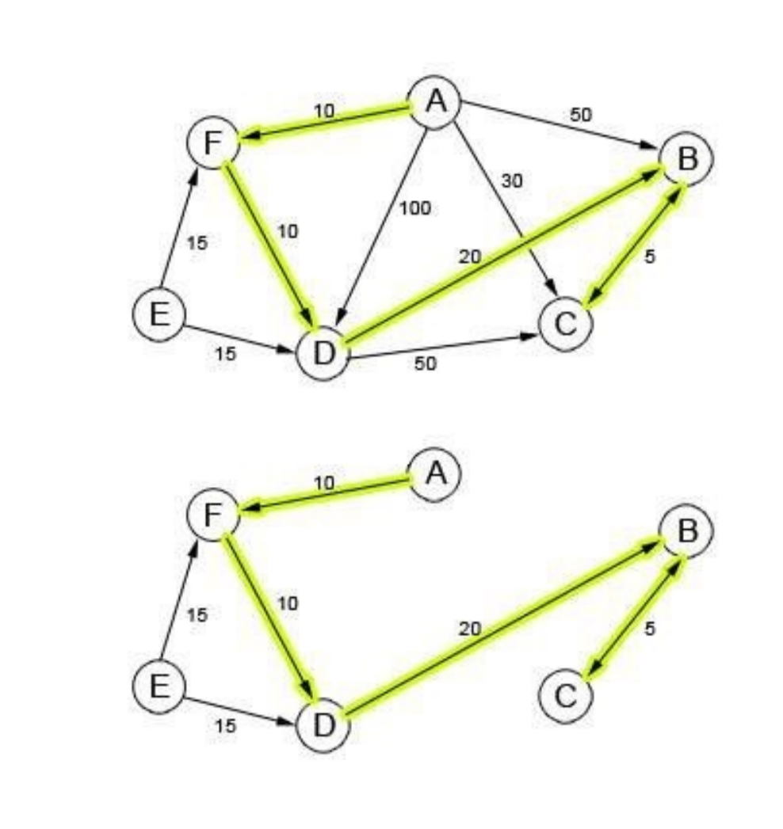
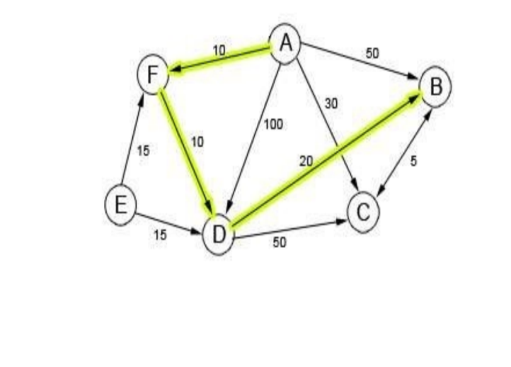
EXAMPLE 2

Slide 20
CODE USING JAVA
// A Java program for Dijkstra's
// single source shortest path
// algorithm. The program is for
// adjacency matrix representation
// of the graph.
class DijkstrasAlgorithm {
private static final int NO_PARENT = -1;
// Function that implements Dijkstra's
// single source shortest path
// algorithm for a graph represented
// using adjacency matrix
// representation
private static void dijkstra(int[][] adjacencyMatrix,
int startVertex)
{
int nVertices = adjacencyMatrix[0].length;
// shortestDistances[i] will hold the
// shortest distance from src to i
int[] shortestDistances = new int[nVertices];
// added[i] will true if vertex i is

Slide 21
// included / in shortest path tree
// or shortest distance from src to
// i is finalized
boolean[] added = new boolean[nVertices];
// Initialize all distances as
// INFINITE and added[] as false
for (int vertexIndex = 0; vertexIndex < nVertices;
vertexIndex++)
{
shortestDistances[vertexIndex] = Integer.MAX_VALUE;
added[vertexIndex] = false;
}
// Distance of source vertex from
// itself is always 0
shortestDistances[startVertex] = 0;
// Parent array to store shortest
// path tree
int[] parents = new int[nVertices];

Slide 22
// The starting vertex does not
// have a parent
parents[startVertex] = NO_PARENT;
// Find shortest path for all
// vertices
for (int i = 1; i < nVertices; i++)
{
// Pick the minimum distance vertex
// from the set of vertices not yet
// processed. nearestVertex is
// always equal to startNode in
// first iteration.
int nearestVertex = -1;
int shortestDistance = Integer.MAX_VALUE;
for (int vertexIndex = 0;
vertexIndex < nVertices;
vertexIndex++)
{

Slide 23
if (!added[vertexIndex] &&
shortestDistances[vertexIndex] <
shortestDistance)
{
nearestVertex = vertexIndex;
shortestDistance = shortestDistances[vertexIndex];
}
}
// Mark the picked vertex as
// processed
added[nearestVertex] = true;
// Update dist value of the
// adjacent vertices of the
// picked vertex.
for (int vertexIndex = 0;
vertexIndex < nVertices;
vertexIndex++)
{

Slide 24
int edgeDistance = adjacencyMatrix[nearestVertex][vertexIndex];
if (edgeDistance > 0
&& ((shortestDistance + edgeDistance) <
shortestDistances[vertexIndex]))
{
parents[vertexIndex] = nearestVertex;
shortestDistances[vertexIndex] = shortestDistance +
edgeDistance;
}
}
}
printSolution(startVertex, shortestDistances, parents);
}

Slide 25
// A utility function to print
// the constructed distances
// array and shortest paths
private static void printSolution(int startVertex,
int[] distances,
int[] parents)
{
int nVertices = distances.length;
System.out.print("Vertex\t Distance\tPath");
for (int vertexIndex = 0;
vertexIndex < nVertices;
vertexIndex++)
{
if (vertexIndex != startVertex)
{
System.out.print("\n" + startVertex + " -> ");
System.out.print(vertexIndex + " \t\t ");

Slide 26
System.out.print(distances[vertexIndex] + "\t\t");
printPath(vertexIndex, parents);
}
}
}
// Function to print shortest path
// from source to currentVertex
// using parents array
private static void printPath(int currentVertex,
int[] parents)
{
// Base case : Source node has
// been processed
if (currentVertex == NO_PARENT)
{
return;
}

Slide 27
printPath(parents[currentVertex], parents);
System.out.print(currentVertex + " ");
}
// Driver Code
public static void main(String[] args)
{
int[][] adjacencyMatrix = { { 0, 4, 0, 0, 0, 0, 0, 8, 0 },
{ 4, 0, 8, 0, 0, 0, 0, 11, 0 },
{ 0, 8, 0, 7, 0, 4, 0, 0, 2 },
{ 0, 0, 7, 0, 9, 14, 0, 0, 0 },
{ 0, 0, 0, 9, 0, 10, 0, 0, 0 },
{ 0, 0, 4, 0, 10, 0, 2, 0, 0 },
{ 0, 0, 0, 14, 0, 2, 0, 1, 6 },
{ 8, 11, 0, 0, 0, 0, 1, 0, 7 },
{ 0, 0, 2, 0, 0, 0, 6, 7, 0 } };
dijkstra(adjacencyMatrix, 0);
}
}
GitHub Link: https: //github.com/SudiptaPandaa/Sudipta/blob/main/DijkstrasAlgorithm.java

Slide 28
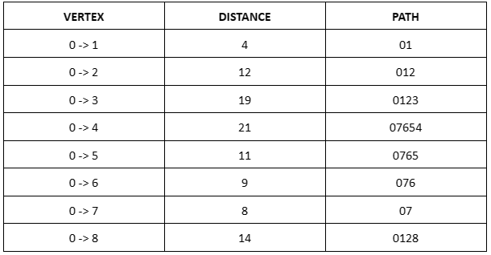
RESULTS AND DISCCUSION
OUTPUT
Time Complexity:- O(V^2)
Space Complexity:- O(V^2)

Slide 29
LIMITATIONS
You must have a complete representation of the graph in order for the algorithm to run.
When working with dense graphs, where E is close to V^2, if we need to calculate the shortest path between any pair of nodes, using Dijkstra’s algorithm is not a good option.
It does a blind search there by consuming a lot of time waste of necessary resources.
It can not handle negative edges.

Slide 30
REFERENCES
Ahuja, Ravindra K.; Mehlhorn, Kurt; Orlin, James B.; Tarjan, Robert E. (April 1990). "Faster Algorithms for the Shortest Path Problem" Journal of the ACM
Avdhesh, K.S., & Sourabh, K., (2013). A finding of the Shortest Path from Source to Destination by traversing every Node in wired Network International Journal of Engineering and Technology, Vol 5, 2655-2656.
N. Biggs, E. Lloyd, and R. Wilson, Graph Theory 1736-1936, Clarendon Press Oxford, 1976.
Deo, Narsingh (1974). Graph Theory with Applications to Engineering and Computer Science, Englewood, New Jersey: Prentice-Hall.
Kleinberg, J., & Tardos, E. (2006). Algorithm design. Pearson Education India.
Cormen, T. H., Leiserson, C. E., Rivest, R. L., & Stein, C. (2022). Introduction to algorithms. MIT press.

